Slide 1
Their Eyes Were Watching God
Working Through the Text

Slide 2
Biography
Birthdate: Jan. 7, 1891 (or 1903!) in Notasulga, Alabama
Zora was the fifth of eight children
Parents: Lucy Potts and John Hurston
Her father was a Baptist preacher, carpenter, and sharecropper.
When Zora was three, her family moved to Eatonville, Florida, the first incorporated black township in America. Her father would eventually become mayor.
Zora’s mother died when Zora was 13 years old. After her mother’s death, Zora’s family passed her around the family for several years.
As a young adult, Zora worked as a waitress and manicurist.
Zora graduated from Barnard College, an affiliate of Columbia University, in 1928.
Hurston published many magazine articles, short stories, and plays during the era of the Harlem Renaissance. Foremost, she was considered a novelist, folklorist, and anthropologist.

Slide 3
Novel and Its Focus
Their Eyes Were Watching God was Hurston’s second novel and was published in 1937. Hurston wrote the novel in seven weeks while living in Haiti.
The novel is the coming of age story of Janie and the three men who ultimately shape her character.
In her Foreword, Mary Helen Washington still has “questions about Hurston’s ambivalence toward her female protagonist, about its uncritical depiction of violence toward women, and about the ways in which Janie’s voice is dominated by men even in passages that are about her inner growth.”
Washington notes: “She puts Janie on the track of autonomy, self-realization, and independence, but she also places Janie in the position of romantic heroine”

Slide 4
Zora’s Choices
She is not concerned with “motive fiction” or “social document fiction”
While she may present difficulties in life, she rejected the notion that black people were defined by the conditions of their existence—whether they lived in the North or the South
While she does not ignore the slavery of the past (the rape of her grandmother and Sherman’s March through Georgia), she also creates her grandmother’s industry, her mother’s abandonment, her discovery of her color, and Janie’s upbringing to develop a different world.
In many ways, the white world is in the background of the novel.

Slide 5
Harsh Criticism
When the novel was published, Alain Locke, Richard Wright and Sterling Brown, all leading forces in the Harlem Renaissance, harshly critiqued the book
Sterling Brown felt “it was not bitter enough, that is did not depict the harsher side of black life in the South” (Washington paraphrase)
Alain Locke critiqued her characters as “pseudo-primitives whom the reading public still loves to laugh with, weep over, and envy” (Locke, Opportunity)
Richard Wright: “Miss Hurston voluntarily continues in her work the tradition which was forced upon the Negro in the theatre, that is, the minstrel technique that makes the ‘white folks’ laugh. . .her novel carries no theme, no message, no thought”

Slide 6
Obscurity
Zora spent her last years in poverty and obscurity. She suffered a stroke in 1959, after which she was committed to the Saint Lucie County Welfare Home in Fort Pierce, Florida. She died there on January 28, 1960, at the age of 69.
With the advent of African American Studies and Women’s Studies programs, a result of the civil rights movement, Hurston gained an underground following.
Alice Walker, writer of The Color Purple, wrote a personal essay, “In Search of Zora Neale Hurston,” in which she found the unmarked grave and place a marker: “Zora Neale Hurston/’A Genius of the South’/Novelist/Folklorist’ Anthropologist/1901-1960.

Slide 7
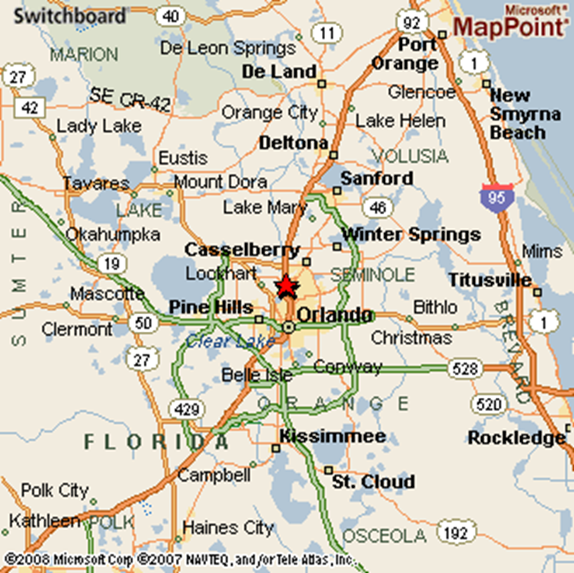
Eatonville
Zora considered Eatonville a utopia, glorified in her stories as a place where black Americans could live as they desired, independent of prejudice in all its ways.

Slide 8
Intro to the Unit
Anticipation Guide
Agree/Disagree and Developing Reasons
Introduction of Themes
Archetypes and Stereotypes
Mythological and Religious Allusions
Society’s Judgments (World of the Characters)
Gender Issues
Rhetorical and Stylistic Strategies

Slide 9
Opening Analogy
“Ships at a distance have every man’s wish on board. For some they come in with the tide. For others they sail forever on the horizon, never out of sight, never landing until the Watcher turns his eyes away in resignation, his dreams mocked to death by Time. That is the life of men.
Now, women forget all those things they don’t want to remember, and remember everything they don’t want to forget. The dream is the truth. Then they act and do things accordingly” (Hurston, 1)
World of Men-Characteristics and Goals
World of Women—Characteristics and Goals
Use of the Analogy to set up an examination of whether the lives of men and women differ in terms of their aims and their living.

Slide 10
Key Plot Points
Janie’s three marriages
Logan Killicks (arranged marriage at 16 and leaves it at 17— doesn’t fulfill Janie’s expectations of marriage should be)
Jody Starks (married at 17 until he dies—promises initially to fulfill her “marriage” ideal, but Janie finds her own voice silenced.
Teacake—woos Janie after Jody’s death, about 10 years young and doesn’t have the financial means but offers the spiritual marriage that Janie seeks and Janie gains her voice.

Slide 11
The Porch Sitters (World of the Characters)
“It was time to hear and talk. These sitters had been tongueless, earless, eyeless conveniences all day long. Mules and other brutes occupied their skins. But now, the sun and the bossman were gone, so their skins felt powerful and human. They became lords of sounds and lesser things. They passed nations through their moths. They sat in judgment” (Hurston 1).
Hurston deliberately chooses to first introduce Janie through the Gossip—the Place of Judgment and their descriptions
The Porch becomes a regular feature in the novel (and place of Judgment in the novel)
Space of the Community Created by The General Store: A place for escape from and for reflection on life.
Dialogue: Allows for Hurston to capture Southern Dialect and Folklore of Florida (directly related to her training and work as an Anthropologist)
Setting the story in Eatonville, the town where Hurston grew up, where her father was mayor

Slide 12
Portrait of Janie
The Town’s Assumptions and Judgments
“What she doin coming back here in dem overalls? Can’t she find no dress to put on?”. .“Where she left dat young lad of a boy she went off here wid?” (2)
“The porch couldn’t talk for looking. The men noticed her firm buttocks like she had grape fruits in her hip pockets; the great rope of black hair swinging to her waist and unraveling in the wind like a plume; then her pugnacious breasts trying to bore holds in her shirt. They, the men, were saving with the mind what they lost with the eye. Then women took the faded shirt and muddy overalls and laid them away for remembrance. It was a weapon against her strength and if it turned out of no significance, sill it was a hope that she might fall to their level some day” (2)
Janie’s Outside Status to the Porch (created throughout Chapters 1-6).
Janie’s Perceptions and Set Up of Her Story (how did she get here)
“Well, Ah see Mouth-Almight is still stiin’in de same place. And Ah reckon they got me up in they mouth now” (5)
“Janie full of that oldest human longing—self revelation” (7)
“They don’t need to worry about me and my overhalls long as Ah still got nine hundred dollars in de bank. Tea Cake got me into wearing ‘em—followng behind him. Teach Cake ain’t wasted up no money of mine, and he ain’t left me for no young gal, neither. He give me every consolation in de world. He’d tell ‘em so too, if he was here. If he wasn’t gone” (7)
Janie retains outsider status when she gives Phoeby to tell her story

Slide 13
Hurston’s Framings in Ch. 2-4
The Pear Tree Analogy
“Janie saw her life like a great tree in leaf with the things suffered” (8)
“She thought awhile and decided that her conscious life had commenced at Nanny’s gate” (10)
“So Janie waited a bloom time, and a green time and an orange time. But when the pollen again gilded the sun and sifted down on the world she began to stand around the gate and expect things” (25)
“Janie pulled back a long time because he did not represent sun-up and pollen and blooming trees, but he spoke for far horizon. He spoke for change and chance. Still she hung back. The memory of Nanny was still powerful and strong” (29)
Activity 1: Tree as Janie’s Womanhood
Create a tree with phrases from the novel and then reflect what they reveal about her conscious life.
Dissection of Marriage
“There are years that ask questions and years that answer. Janie had no chance to know things, so she had to ask. Did marriage end the cosmic loneliness of the unmated? Did marriage compel love like the sun the day? “ (21)—Beginning of Chapter 3
“She knew now that marriage did not make love. Janie’s first dream was dead, so she became a woman” (25)—End of Chapter 3
“Long before the year was up, Janie noticed that her husband had stopped talking rhymes to her. He had ceased to wonder at her long black hair and finger it. Six months back he had told her . . . ‘You done been spoilt rotten’” (26).—Beginning of Chapter 4
Activity 2: 3-Pieces of the Pie
Create a 3-Part Graph which reflects the different expectations/goals of marriage
Nanny’s desire to have Janie married (12-20) & Her Marriage Advice (22-24)
Janie’s Expectation of Marriage (throughout 2-4)
Logan Killicks’ Expectations of Marriage (3-4)

Slide 14
Activity 3: Theme Character Charts: Brainstorm Roles and Stereotypes
Jody Starks
Physical Appearance
What Jody says
What others say about Jody
What Janie says about Jody
Actions
View of Marriage
Role as Mayor
Voice in the Community
Janie Starks
Physical Appearance
What Janie says
What others say about Janie
What Jody says about Janie
Actions
View of Marriage
Role as Mayor
Voice in the Community

Slide 15
Archetypes and Stereotypes
Recurring Literary Archetypes
Earth Mother (Nanny’s Life Story)
Virgin (Janie has a young woman)
Fallen Woman (Janie’s return to Eatonville, Janie’s absent mother)
Cuckold Husband ( Logan Killicks)
Showman (Jody Starks)
Recurring Stereotypes
Man as provider/protector
Wife as Prize
Successful/Ambitious Male
Obedient Wife
Lazy Husbands
Political Wife

Slide 16
Socratic Themes to Consider
Personal freedom Spiritual v. materialistic value Self identification Quest for life's experiences Search for autonomy Struggle of a woman to be regarded as a person | Model of female development Use of story-telling Story within a story Black folklore and folk culture Humor in black literature
Activity 4: Develop 2 Socratic Questions for each column

Slide 17
7-14 Anticipation Guide—Fast Talk
Assigned 1-10—30 Second Expert on the Position
Examples and Counter-Examples
Class Vote

